Slide 1
Git Exercise for DSPG
Yang Cheng
2022

Slide 2
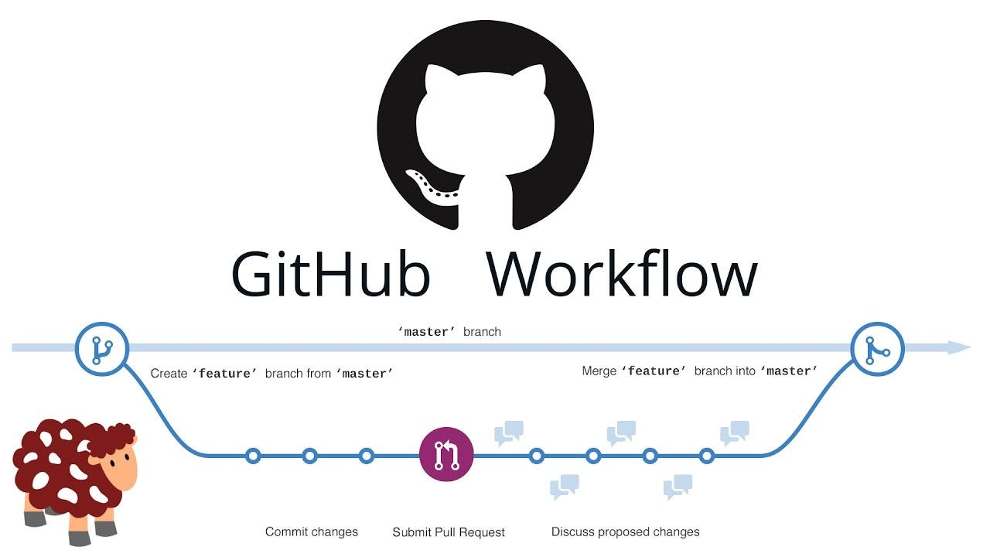

Slide 3
Team Up
Fellows | Samantha | Leonard-Allen | Poonam | Nazmul | Nandini
Intern #1 | Siddarth | Ari | Catherine | Christopher | Amanda
Intern #2 | Taj | Josue | Milind | John | Chaudhry
Intern #3 |  | Frankie | Riley | Rachel | Tay

Slide 4
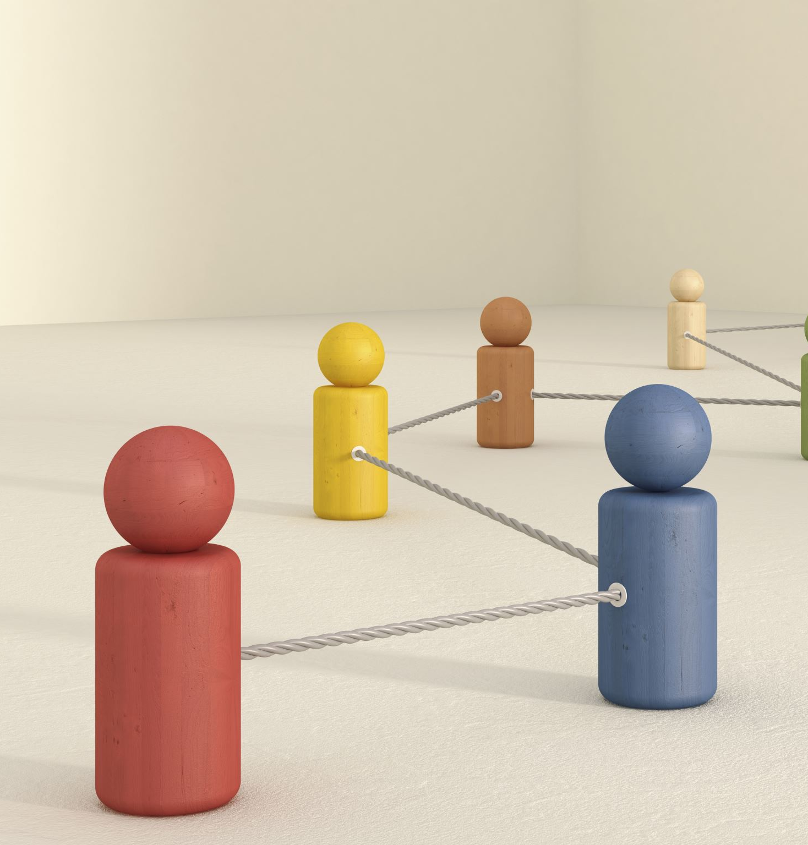
Plans
Set up repositories for team practice
Clone repository of your team
Branch
Stage, commit, pull, and push
Pull request and merge
Resolve a merge conflict
Team Exercise

Slide 5
Set up repositories
Fellows:
Create a new practice repository
Add readme.md file
Create folders such as “data” and “images” etc
Add interns as collaborators
Interns:
Go to your Email inbox and accept the invitation
Explore the GitHub page for the practice repository
Download the geo data and unzip it into the data folder

Slide 6
Clone repository of your team
Interns:
Log in to your GitHub account
Hint: https://ndporter.github.io/dspg-r-2022/02-project-intro/index.html#a-possible-solution
Go to GitHub and find the repository for your team practice
Note and examine the structure of the repo you have cloned. Check the names of folders and readme file
Clone the repository

Slide 7
Branch
Do a pull before branching
Add a new branch called “Yourname-branch”
Fellows check branches in GitHub

Slide 8
Stage, commit, pull, and push
Interns: Create and Share a Text File Using RStudio and GitHub
Branch Awareness: Make sure you are working in your own branch in RStudio. This is crucial!
Text File Creation:
Open RStudio and create a new Text file.
Save the file as "YourName-txt" (no spaces).
Content Addition:
Add at least two paragraphs to the text file.
Save your changes.
Git Operations in RStudio:
Navigate to the Git panel within RStudio.
Stage your changes.
Commit with meaningful messages.
Perform a 'Pull' operation to update your local repository.
Finally, 'Push' your changes to the remote repository.
Verification on GitHub:
Go to GitHub and navigate to your team repository.
Verify that your branch is updated in the cloud-based repository.

Slide 9
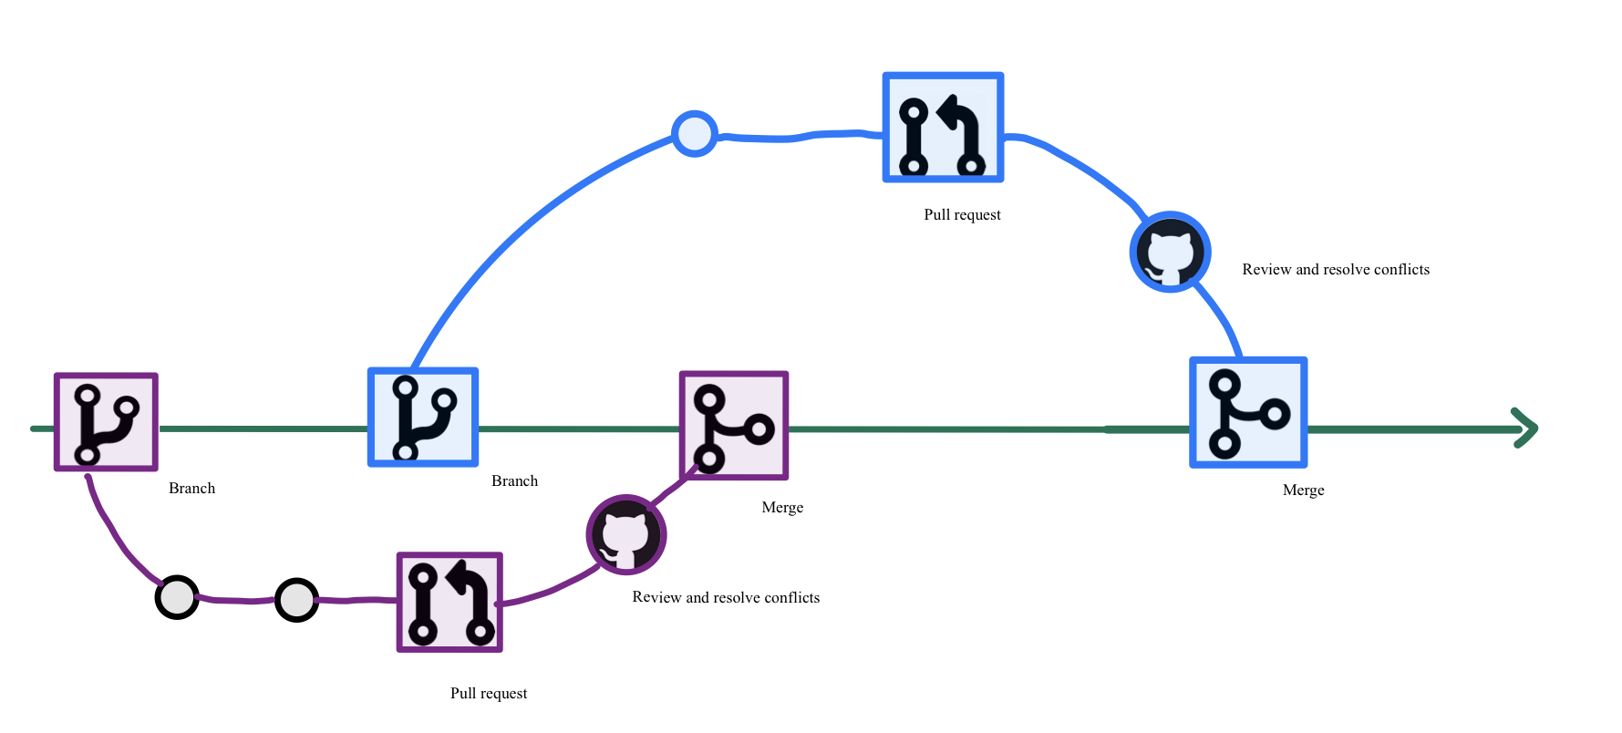

Slide 10
Pull Request and Merge
Pull Request (Interns)
Branch: Work on your changes in a branch of the project.
Commit: Once you're happy, commit these changes to your branch.
Push: Push this branch to the repository.
Request: File a Pull Request online (GitHub), asking the fellows to review and pull your changes into the main branch of the project.
Merge (Fellow)
Review: Look at the changes proposed in a Pull Request and decide if they fit with the project.
Resolve Conflicts: Sometimes, you and a teammate might have changed the same piece of code. You'll need to decide which changes to keep.
Merge: Once you're happy with the changes and any conflicts are resolved, you combine (merge) the Pull Request's branch with the main version of the project.

Slide 11
Resolve a merge conflict
Interns: Practicing Conflict Resolution in Git
Objective: Learn to resolve Git conflicts by editing the same code file simultaneously.
Initial Setup: Make sure everyone is in member #1's branch in RStudio. Pull the latest version of the code.
Conflict Creation: Each of you will edit the second line of the #1 member's txt file. Save your changes.

Slide 12
Conflict Resolution Steps
Member #1
Commit your changes.
Member #2
Commit your changes.
Member #3
Commit your changes.
Member #1 (Again)
Edit the txt file, changing the second line.
Pull the latest version from the remote repository.
Push your changes to the repository.
Attempt a 'Pull' (expect an error message).
Resolve the conflict.
Pull again and then Push.
Attempt a 'Pull' (expect an error message).
Resolve the conflict.
Pull again and then Push.
Commit your changes.
Attempt a 'Pull' (expect an error message).
Resolve the conflict.
Pull again and then Push.
Fellow: Check the text file to see how it has changed. You will resolve the merge conflicts all the time!

Slide 13
Team Up
Fellows | Samantha | Leonard-Allen | Poonam | Nazmul | Nandini
#1 | Siddarth | Ari | Catherine | Christopher | Amanda
#2 | Taj | Josue | Milind | John | Chaudhry
#3 |  | Frankie | Riley | Rachel | Tay

Slide 14
Team Exercise: Create a Collaborative R Markdown
Instructions:
Form Your Teams: Gather into your designated teams. You will work on your own branch this time.
Initialize R Markdown File: Fellows create a new R Markdown file in your team's repository on main branch.
Data Preparation: Ensure that the data you plan to use is already in your repository and easily accessible. Feel free to use code and data from Dr. Porter's training, but copy it into your new R Markdown file.
Assignment:
Interns:
Work on creating maps, histograms, or line graphs in the R Markdown file on your own branch.
Add your name in the file header.
Ensure formatting consistency across the R Markdown file.
Each intern should contribute at least one diagram.
Pull request
Fellows:
Troubleshoot issues.
Review Pull request, resolve conflicts, and merge branches
Organize the repository to keep it clean and accessible.

Slide 15
Workflow for DSPG
Interns: work in the branch for specific goals
Interns: stage, commit, pull, and push, pull request
Fellows: pull the branches back to main
Fellows: create different branches for different goals

